Slide 1
Experimental Details for Blinded Healthy and Breast Cancer Plasma Samples
Used samples: 36, 43, 44, and 45.
Plasma volume: 20 µl.
Type of Cancer: Lung cancer H460
Concentration: unknown.
Size Distribution: unknown.
Experimental duration: 60 min.
Antibody used: CD9, CD81, and CD63.

Slide 2
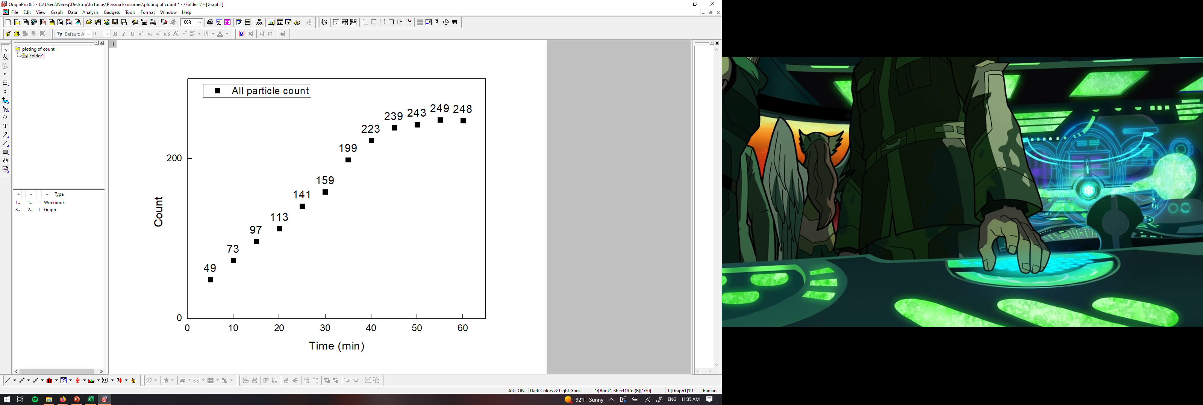
PANORAMA of mouse 36 (4-28-2022)
Time: 60 min
Count: 248 (Ex: 178; Large: 70)
Time: 60 min wash
Count: 9
Note: 0 % response to miRNA-21
Scale bar: 10 µm

Slide 3
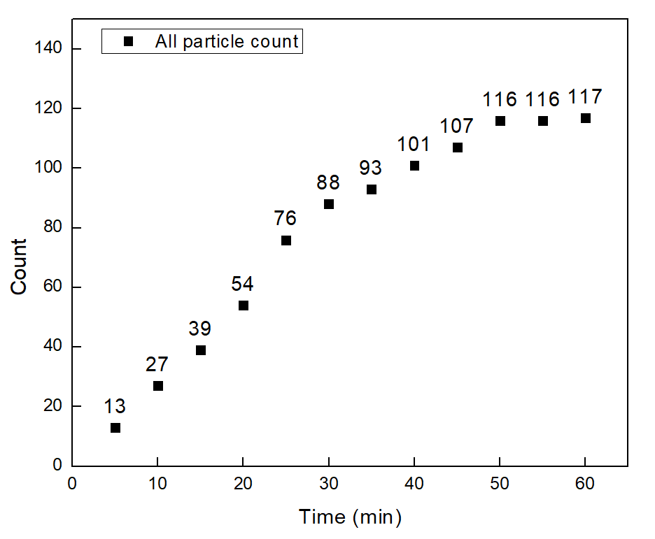
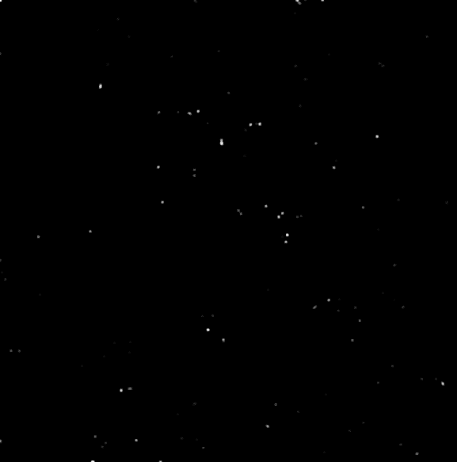
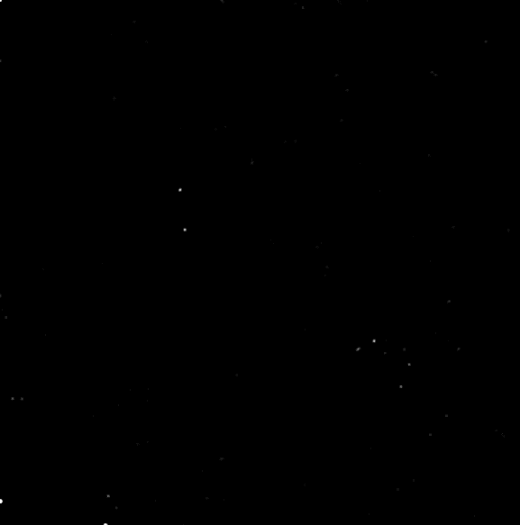
PANORAMA of mouse 36 (5-5-2022)
Time: 60 min
Count: 117 (Ex: 112 ; Large: 5)
Time: 60 min wash
Count: 7
Note: 0 % response to miRNA-21
Scale bar: 10 µm

Slide 4
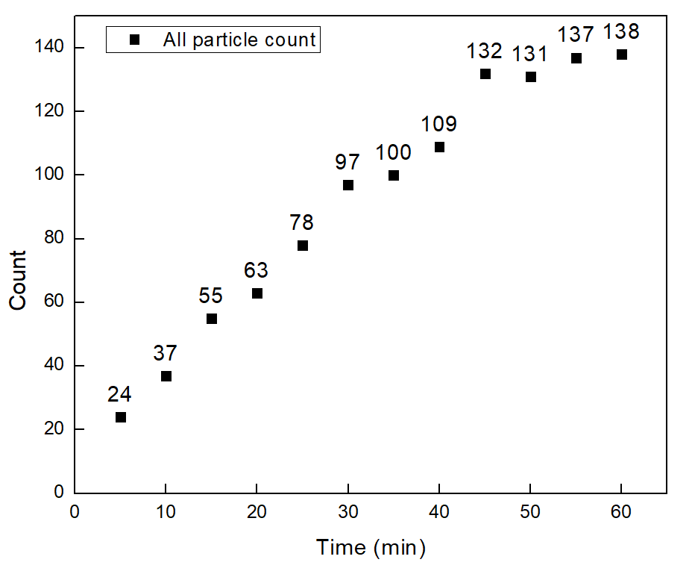


PANORAMA of mouse 36 (5-12-2022)
Time: 60 min
Count: 138 (Ex: 113; Large: 25)
Time: 60 min wash
Count: 18
Note: 0 % response to miRNA-21
Scale bar: 10 µm

Slide 5
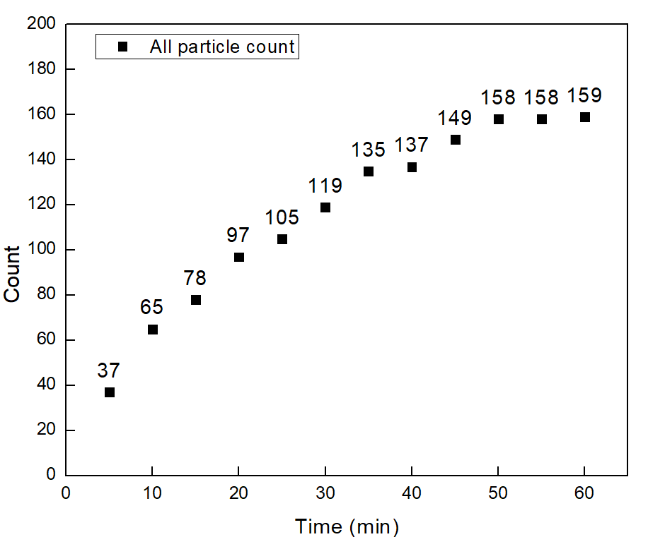

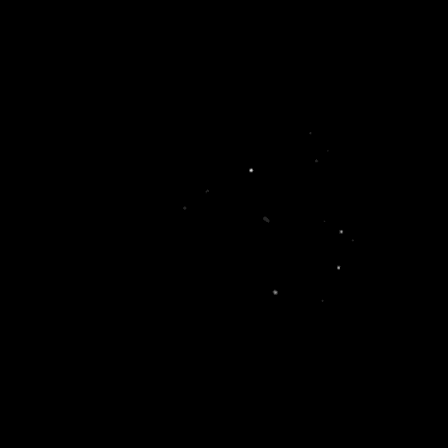
PANORAMA of mouse 36 (5-19-2022)
Time: 60 min
Count: 159 (Ex: 136; Large: 23)
Time: 60 min wash
Count: 13
Note: 0 % response to miRNA-21
Scale bar: 10 µm

Slide 6
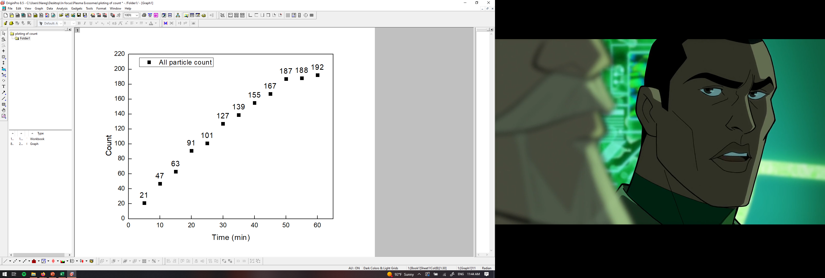
PANORAMA of mouse 36 (5-28-2022)
Time: 60 min
Count: 192 (Ex: 145; Large: 47)
Time: 60 min wash
Count: 28
Note: 0 % response to miRNA-21
Scale bar: 10 µm

Slide 7
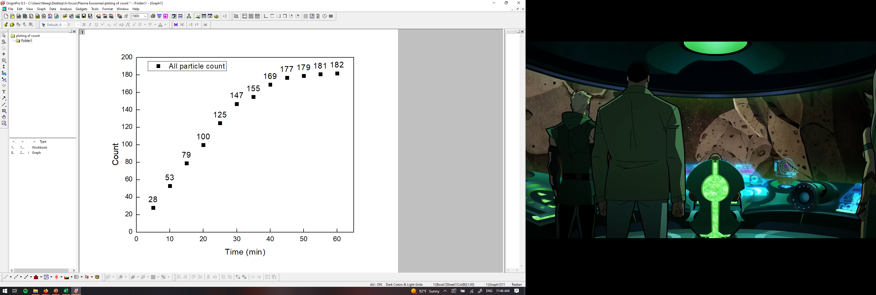

PANORAMA of mouse 36 (6-5-2022)
Time: 60 min
Count: 182 (Ex: 142; Large: 40)
Time: 60 min wash
Count: 31
Note: 0 % response to miRNA-21
Scale bar: 10 µm

Slide 8
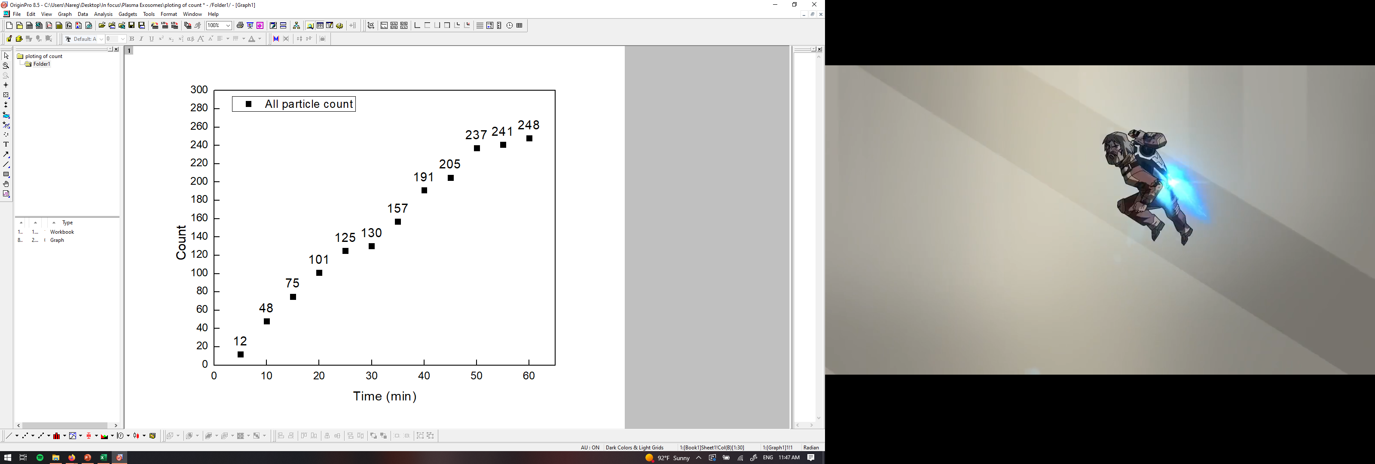

PANORAMA of mouse 43 (4-28-2022)
Time: 60 min
Count: 248 (Ex: 178; Large: 70)
Time: 60 min wash
Count: 32
Note: 0 % response to miRNA-21
Scale bar: 10 µm

Slide 9
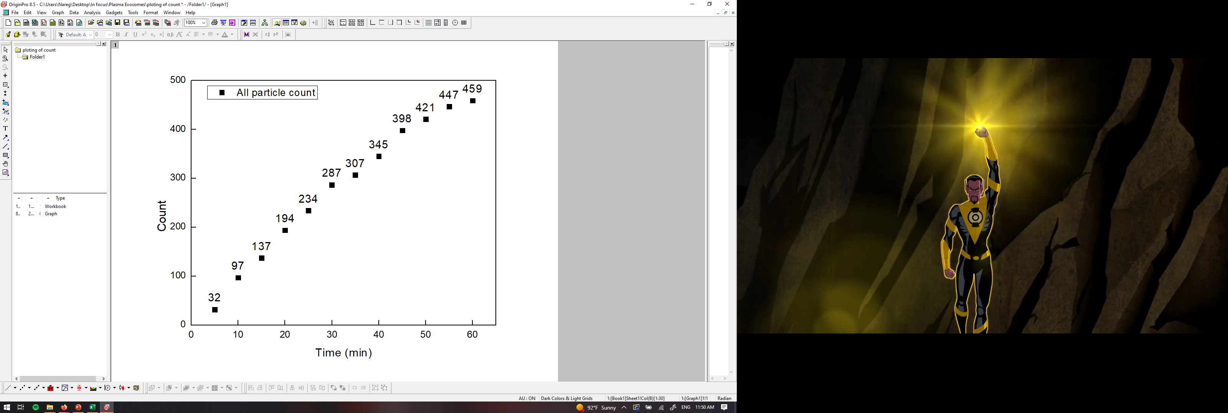
PANORAMA of mouse 43 (5-5-2022)
Time: 60 min
Count: 459 (Ex: 255; Large: 204)
Time: 60 min wash
Count: 84
Note: 5 % response to miRNA-21
Scale bar: 10 µm

Slide 10
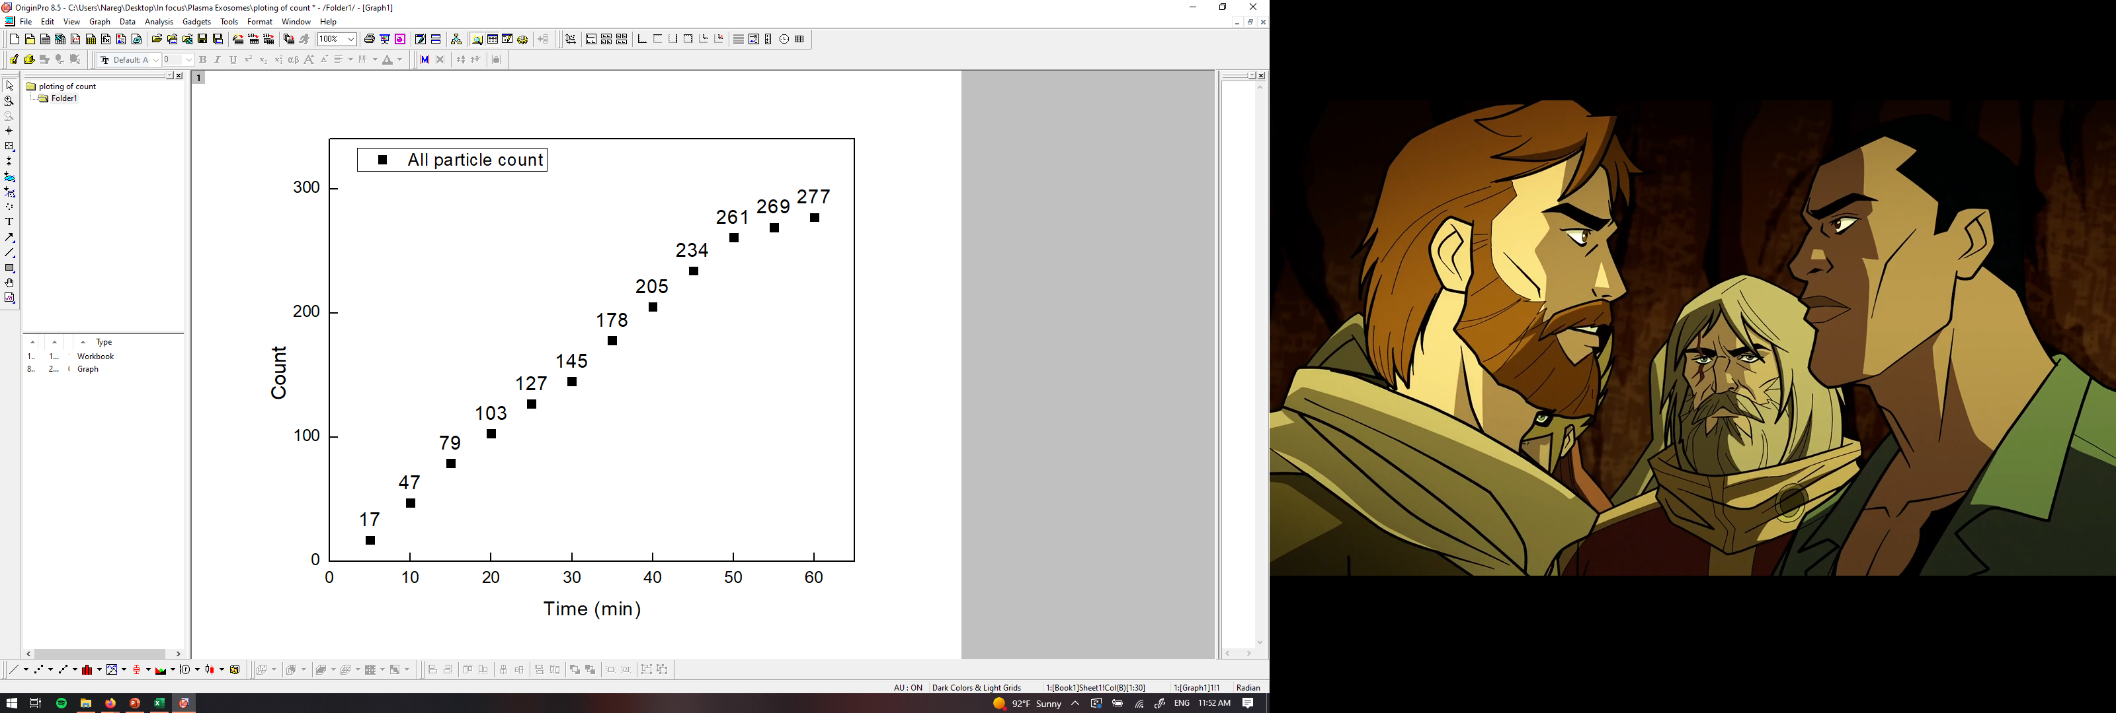
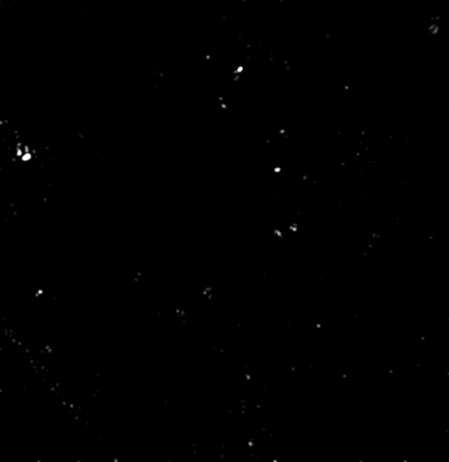
PANORAMA of mouse 43 (5-12-2022)
Time: 60 min
Count: 277 (Ex: 167; Large: 110)
Time: 60 min wash
Count: 63
Note: 31 % response to miRNA-21
Scale bar: 10 µm

Slide 11
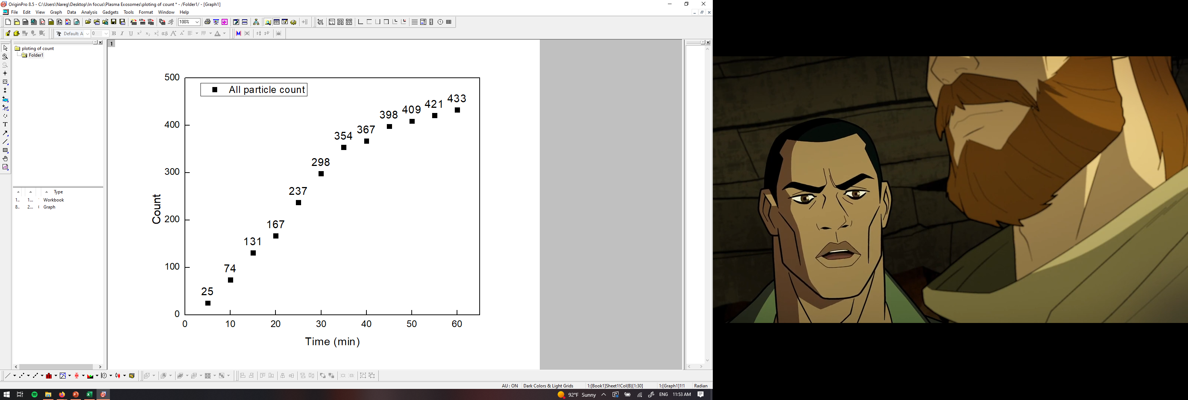
PANORAMA of mouse 43 (5-19-2022)
Time: 60 min
Count: 433 (Ex: 358; Large: 75)
Time: 60 min wash
Count: 161
Note: 35 % response to miRNA-21
Scale bar: 10 µm

Slide 12
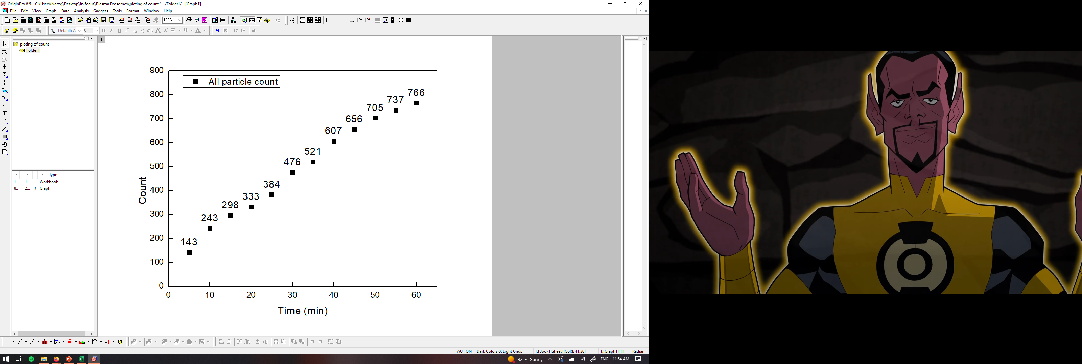

PANORAMA of mouse 43 (5-28-2022)
Time: 60 min
Count: 766 (Ex: 505; Large: 261)
Time: 60 min wash
Count: 254
Note: 41 % response to miRNA-21
Scale bar: 10 µm

Slide 13
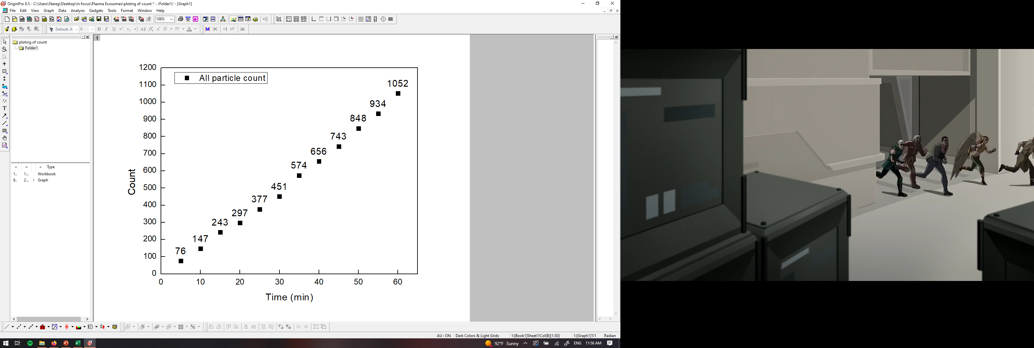

PANORAMA of mouse 43 (6-2-2022)
Time: 60 min
Count: 1052 (Ex: 826; Large: 226)
Time: 60 min wash
Count: 268
Note: 45 % response to miRNA-21
Scale bar: 10 µm

Slide 14
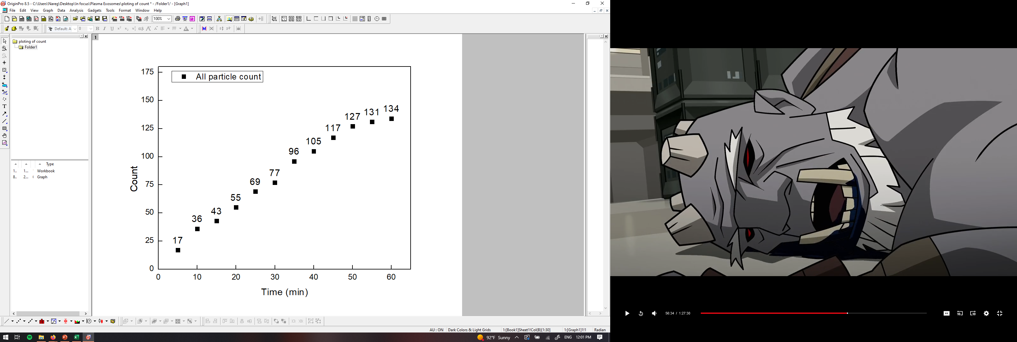

PANORAMA of mouse 44 (4-28-2022)
Time: 60 min
Count: 134 (Ex: 91; Large: 43)
Time: 60 min wash
Count: 27
Note: 0 % response to miRNA-21
0% response for GFP
Scale bar: 10 µm

